Slide 1
DevOps Technical Assessment - AMBOSS
Deploy to Kubernetes cluster one of the applications

Slide 2
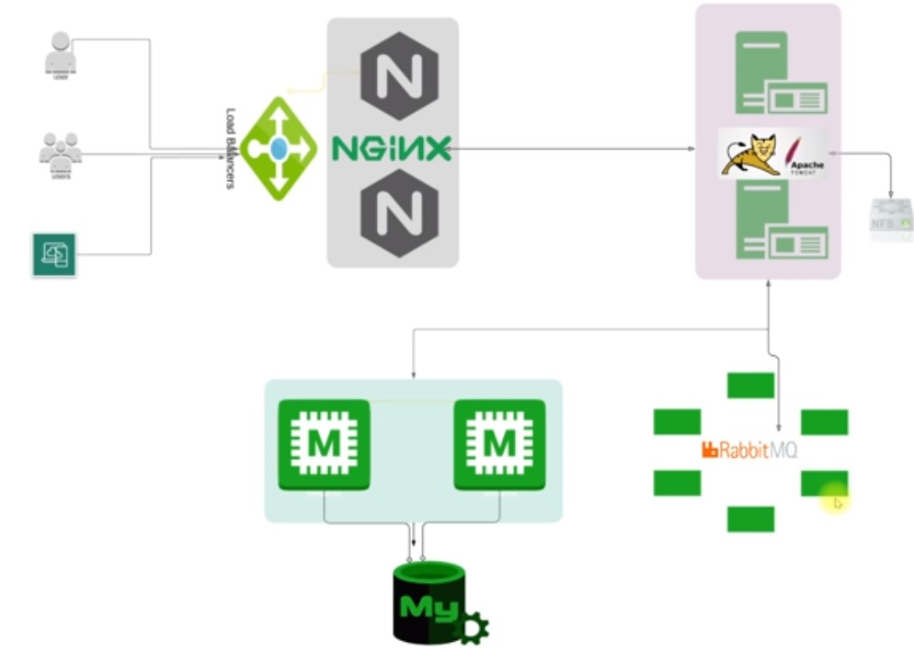
Existing Legacy Employee Profile App Architecture

Slide 3
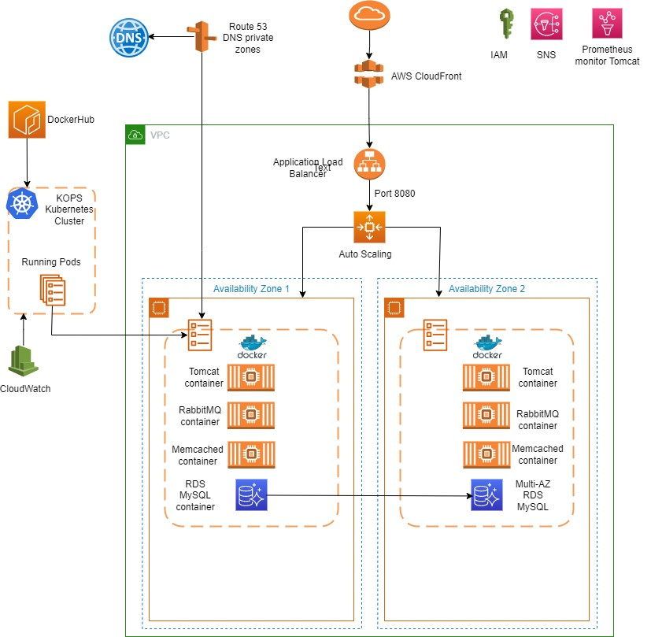

Slide 4
Containerization of Java Spring App using Docker
Required Docker Images
Images customized for this app
Apache Tomcat
MySQL
The java spring app
Default Docker Images (not customized)
Nginx – used to test during docker-compose, will be replaced with AWS ALB
Memcached
RabbitMQ

Slide 5
Build the Java Spring app with Maven
Install Vagrant on Windows 11 laptop
Create a Ubuntu vm in Oracle VirtualBox using vagrantfile
Install maven software in the Ubuntu server
Install docker & add vagrant user to docker group, re-login
We will build 3 images: nginx, mysql & tomcat
Test the built images with docker-compose
Push docker images to dockerhub
Following other images will be used default, no changes needed:
Nginx – will be replaced with AWS ELB during deployment
Memcached
RabbitMQ

Slide 6
Kubernetes setup for production: Kops cluster setup
Requirement
High Availability - HA cluster we should use, at least, 3 zones, with one master in each one. For test & small cluster 2 Azs ok.
Fault Tolerant
Easily Scalable
Platform Independent
Portable & Flexible
Pre-requisites
A domain for kubernetes cluster:
Created in godaddy.com – darwinpro.live
Create a Ubuntu VM in AWS and install following software:
kops
kubectl
ssh keys
awscli
Setup following service in your AWS account:
S3 bucket - store kops cluster state, benefit can run kops commands from anywhere
IAM user for AWS CLI - programmatic access, policy: Admin access
Route 53 hosted zone - We get the NS server URLs, add them to godaddy DNS records

Slide 7
Production Kops command for K8s cluster setup
Create smaller cluster having one master & 2 nodes (not suitable for production)
$ kops create cluster \
--name=kube.darwinpro.live \
--state=s3://javaspringapp-kops-states \
--zones=eu-central-1a,eu-central-1b \
--node-count=2 \
--node-size=t3.small \
--master-size=t3.medium \
--dns-zone=kube.darwinpro.live \
--node-volume-size=8 \
--master-volume-size=8
The command creates config only and stores the state in S3 bucket.
Run this command to start the K8s cluster creation:
$ kops update cluster --name kube.darwinpro.live --state=s3://javaspringapp-kops-states --yes –-admin
This will take time, about 15 minutes.
$ kops validate cluster --state=s3://javaspringapp-kops-states
Should say your cluster is ready.
$ kubectl get nodes

Slide 8
Create Production HA cluster with 3 masters and 3 availability zones:
$ kops create cluster \
--state "s3:// javaspringapp-kops-states" \
--zones "us-east-1d,us-east-1f, us-east-1b" \
--master-count 3 \
--master-size=t2.micro \
--node-count 2 \
--node-size=t2.micro \
--name kube.darwinpro.live \
--yes
Master-count must be odd.

Slide 9
KOPS K8s cluster management
You get node list, visible in your AWS console also. Autoscaling group also visible in AWS, you can also see a separate VPC in AWS, also route 53 you will see new records. You can delete cluster, if not required, as you will be charged.
$ kops delete cluster --name=kube.darwinpro.live --state=s3:// javaspringapp-kops-states --yes
Deletion also takes time as it deletes all resources like VPC, groups etc.
Don’t delete manually.

Slide 10
Java app deployment on Kubernetes
STEPS:
Use the kops k8s cluster created in previous section
Use the docker containers created from dockerhub
Create EBS volume for the DB Pod
Label nodes with zone names
Create kubernetes deployment files for:
Deployment
Service
Secret - Need to create kube secrets file to store DB, MQ credentials from application.properties file, once k8s cluster is installed, as first action.
EBS Volume – Persistent volume for MySQL DB
Upload in a GIT repository & clone in the KOPS EC2 VM.

Slide 11
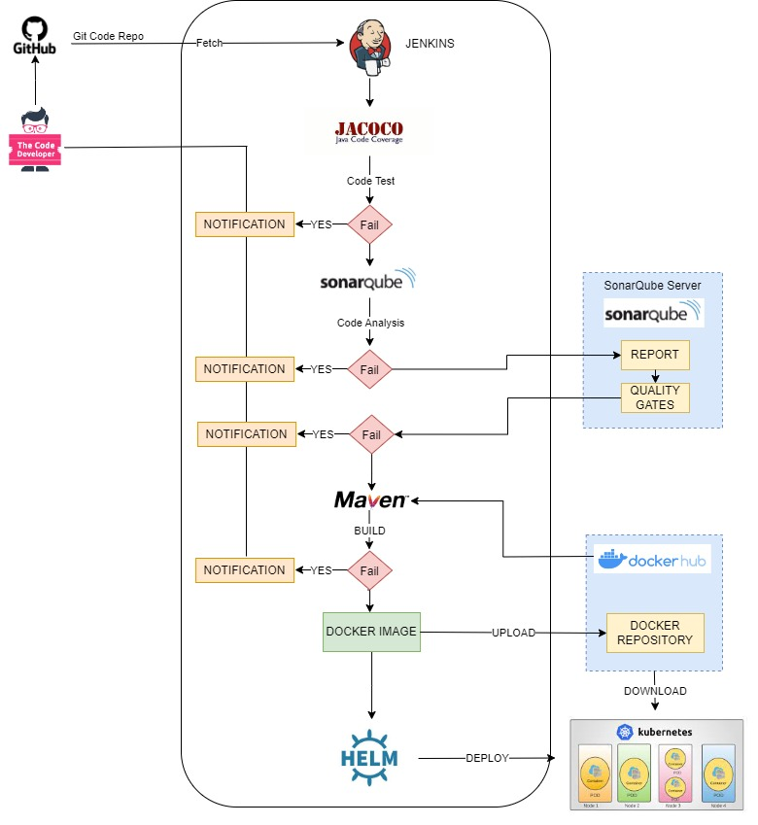
Automated CI / CD Pipeline

